Slide 1
GERMANY
By Peter W

Slide 2
FACTS
Germany has a population of 81 million people.
One-third of Germany is still covered in forests and woodlands.
Germany is a member of the European Union.
65% of the highways in Germany (Autobahn) have no speed limit.
University is free for everyone (even non-Germans).
There are over 2100 castles in Germany.
There are over 1,500 different beers in Germany.
Germany is the seventh-largest country in Europe. Covering an area of 137,847 square miles, of which 34,836 square miles is covered by land and 3,011 square miles contains water.

Slide 3
GERMANY FLAG

Slide 4
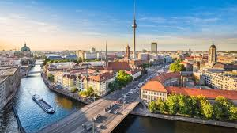
Map of Germany
Berlin is the capital of Germany

Slide 5
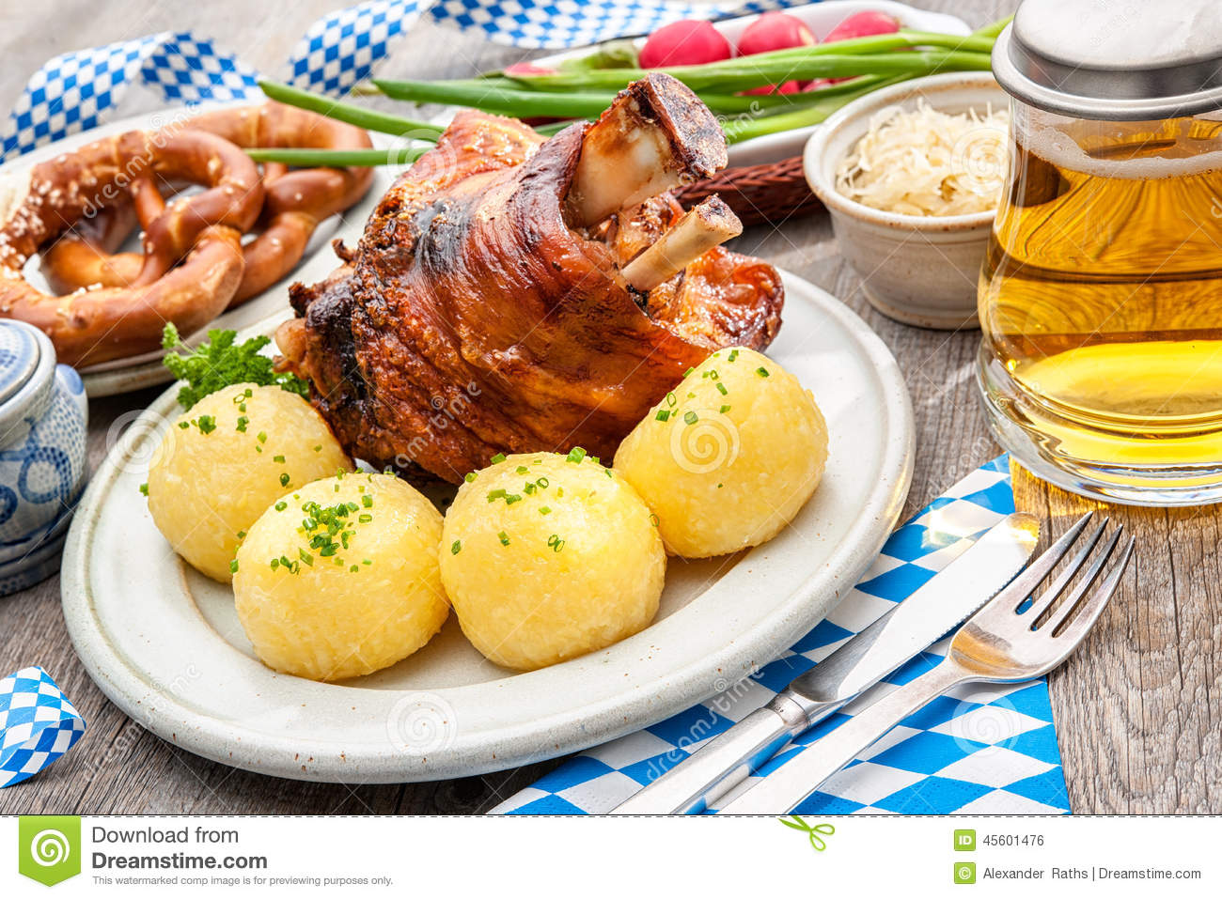
TRADITIONAL FOODS
Sauerbraten (Roast Beef Stew)
Schweinshaxe (Pork Knuckle)
Rinderroulade (Beef Roll)
Bratwurst (Grilled Sausage)
Kartoffelpuffer (Potato Pancake)
Kartoffelkloesse (Potato Dumplings)
Sauerkraut (Fermented Cabbage)
Spätzle (Egg Noodles)
Picture of Schweinshaxe

Slide 6
Germany ww2 Facts
World War II in Europe began when Hitler's Nazi Germany attacked Poland. Germany had allies such as Italy, Hungary, Bulgaria, and Romania. These European countries were part of the Axis Powers. The countries that fought against Germany and the Axis Powers in Europe were called the Allied Powers. The main Allied Powers in Europe were Great Britain, the Soviet Union, and France. Later the United States would help in defeating Hitler.

Slide 7
BERLIN WALL
The fall of the Berlin Wall in 1989 was a momentous moment in history, it marked the end of the Cold War and Soviet Union rule.
The wall was built in 1961, it literally and metaphorically was the divide between the Capitalist West and Communist East. You can still see some parts of the wall dotted throughout the city, as a reminder of Berlin’s fascinating historical past.
A preserved section of the Berlin Wall, approximately 1.3km, has been turned into an open-air art gallery and graffiti artists from around the world have made their creative mark on it. Possibly the most famous piece ‘My God, Help Me to Survive This Deadly Love’ or ‘Fraternal Kiss ’ replicates the famous photo of Soviet Leader Brezhnev and leader of East Germany Erich Honecker engaging in the socialist fraternal kiss.
My dad was at the destruction of the wall.

Slide 8
TRADITIONS
The people, language, and traditions are what make the German culture unique. It has had a key role in the history of Europe, and not only. English speakers call it Germany, Germans themselves call it Deutschland. Germany is known as the country of poets and thinkers.
German culture has been influenced and shaped throughout Germany‘s rich history once as an important part of The Holy Roman Empire, and later on as one of the most stable economies in the world.
Through time Germany has lost and gained different traits from the historical events that have shaped not only Germany but the whole old continent of Europe.
Though English-speaking countries call it Germany, Germans themself call it Deutschland. It is Germania in Latin, l’Allemagne in French and Almanya in Turkish.
Berlin is its capital, but Hamburg, Munich and Cologne are also among the main cities of Germany. It is estimated that the average woman in Germany lives around 83 years, while the average man lives 79 years. The main language is German and main religion is Christianity.
There are a lot of stereotypes about Germans, as that they drink a lot of beer (which is true), they are hardworking and punctual (which is also true), and that the rate of unemployment in Germany is very low (true again).

Slide 9
German made cars
If you know just a little about cars, then you must know that some of the most popular car manufacturers are from Germany, as Audi, Volkswagen, BMW and Mercedes-Benz.
There are even car museums and factory tours for tourists who are car enthusiasts.
The well-maintained roads in Germany offer a great experience for drivers. What makes them love their cars even more is that you may go as fast as you like on the Autobahn.

