Slide 1
Recognising Poetry
Haikus

Slide 2
Learning Objective
To recognise the features of haiku poems.
Success Criteria
Know that a haiku contains only 3 lines.
Counting the syllables in each line to check the pattern matches the format 5-7-5.
Understand that haiku poems are often about nature or the seasons and how we feel about them.

Slide 3
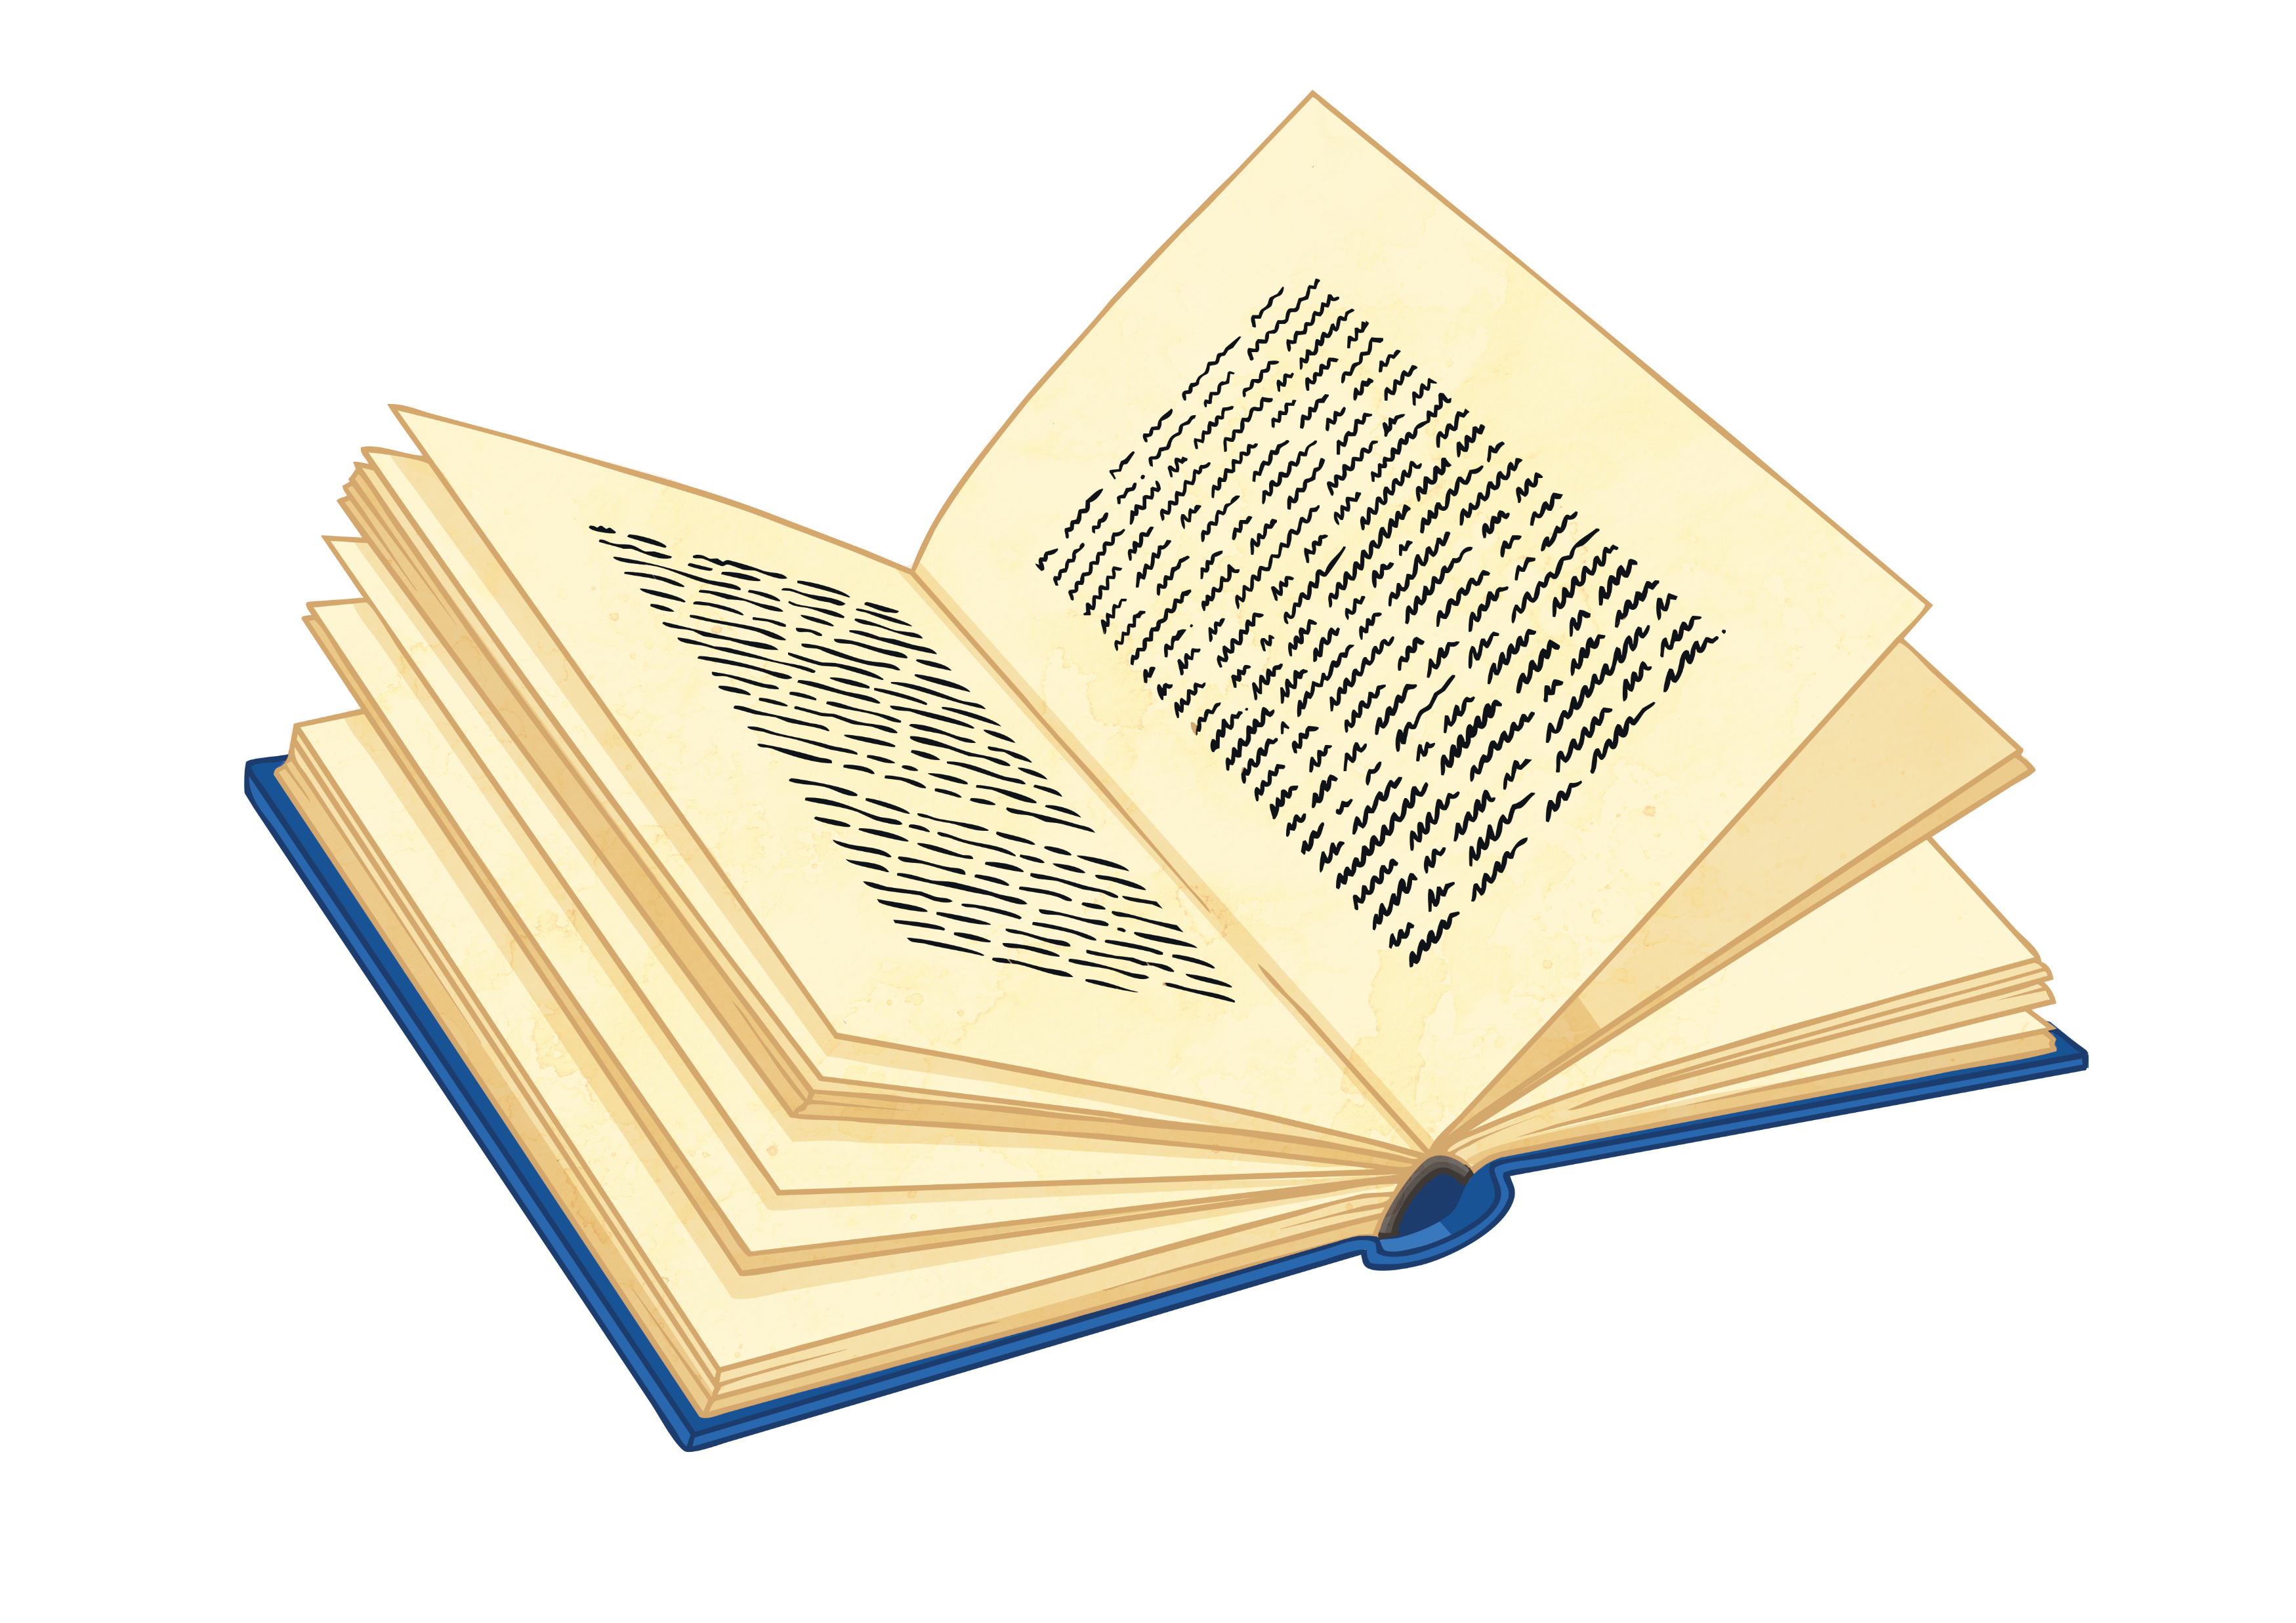
What Is a Haiku?
Here’s another...
Winter is coming.
Snow will be arriving soon.
We should rake the leaves.
Haiku poems are a traditional Japanese art form. Here’s one...
My two plum trees are
So gracious. See, they flower.
One now, one later.

Slide 4
What Did You Notice About the Poems?
Think about:
the poem’s theme;
how many lines are in each poem;
how many syllables in each line.
My two plum trees are
So gracious. See, they flower.
One now, one later.
Winter is coming.
Snow will be arriving soon.
We should rake the leaves.
5 syllables in first line,
7 syllables in middle line,
5 syllables in final line.
Final line is a comment or observation on the theme.
Natural theme.
Three lines in each poem.

Slide 5
How Can We Write a Haiku?
First, we need to choose a theme. It doesn’t have to be about seasons or nature, but let’s be traditional.
Summer
Then, we brainstorm some words or phrases associated with that theme…
hot | sunshine | flowers | holiday
beach | ice-cream | games | sea
swimming | fun | warm | sand

Slide 6
How Can We Write a Haiku?
Next, we choose two or three ideas which will flow together.
hot | sunshine | flowers | holiday
beach | ice-cream | games | sea
swimming | fun | warm | sand
hot | sunshine | flowers | holiday
beach | ice-cream | games | sea
swimming | fun | warm | sand
Now we have our ideas, let’s try to fit them into the 5-7-5 syllable format.
You might have to alter words or phrases slightly fit the pattern.

Slide 7
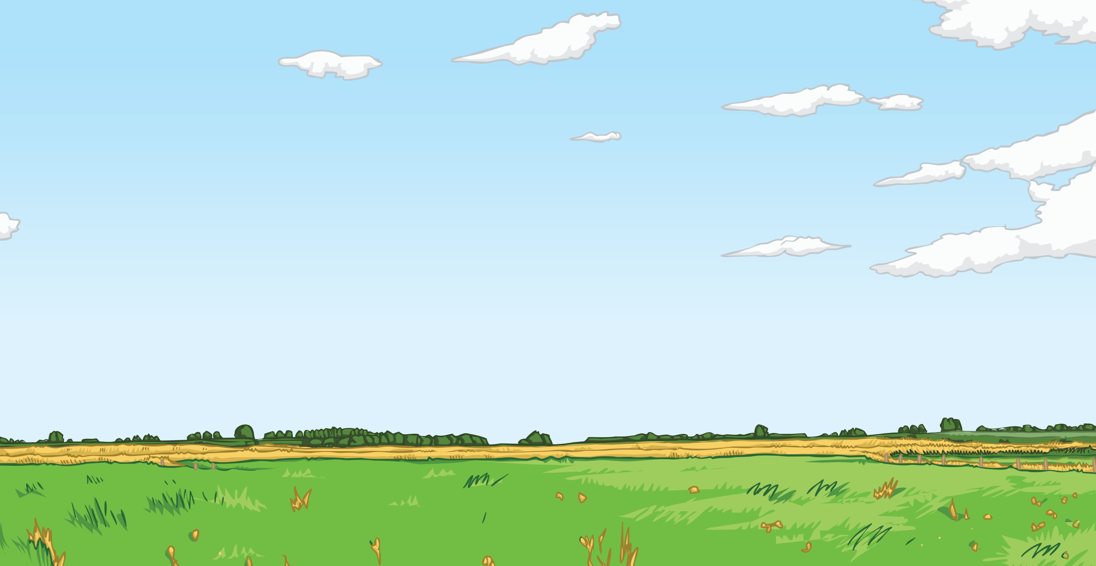
Let’s Have a Go!
You could write a haiku about the seasons, or about an animal or plant. The choice is yours!

Slide 8
Plenary
What have we learned about Haiku?
Each poem has only 3 lines.
The syllable pattern of the poem should be 5-7-5.
Haiku are often written about seasons and nature.
So now you know – a haiku is a poem, not something a pigeon says on the top of Nelson’s Column!

